Slide 1
Microsoft Graph REST API
Build applications using Microsoft Graph REST API

Slide 2

Microsoft Graph REST API
Intro to the Microsoft Graph REST API
Getting started
SDKs & Code Samples
Resources

Slide 3
Developer vision
USERS
DATA
HTML
Notes:
Our Office 365 developer vision focuses on the Users’ experience and their data. As a developer you can bring your applications into their user experience. With over 1.2+ billion users of Office Worldwide, this is a huge opportunity to provide a window into your applications. As well as being able to connect into their data and add intelligence to your applications. There are currently 850 million events created a month and a total of 470Pb+ of data stored in the service that can add value to for our Users’.

Slide 4
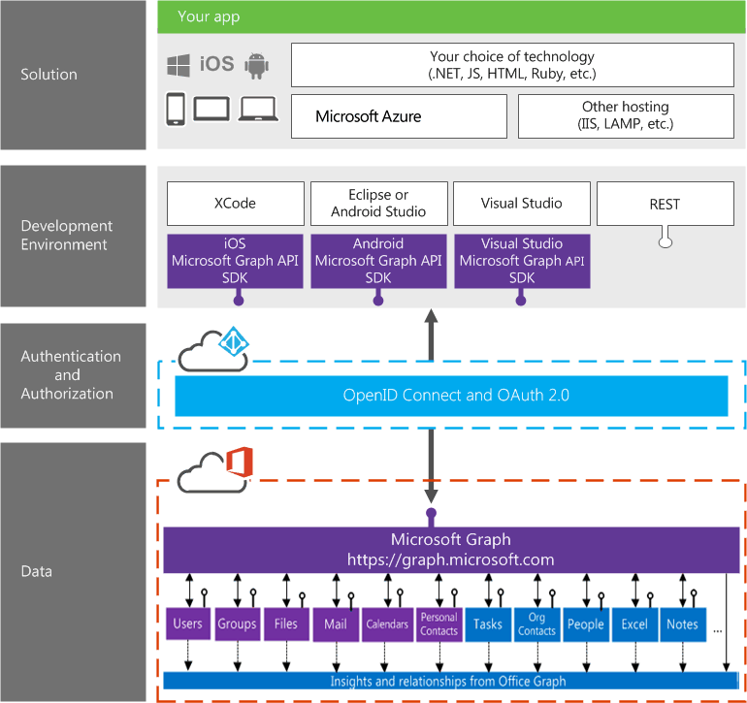
Building integration with Office 365

Slide 5
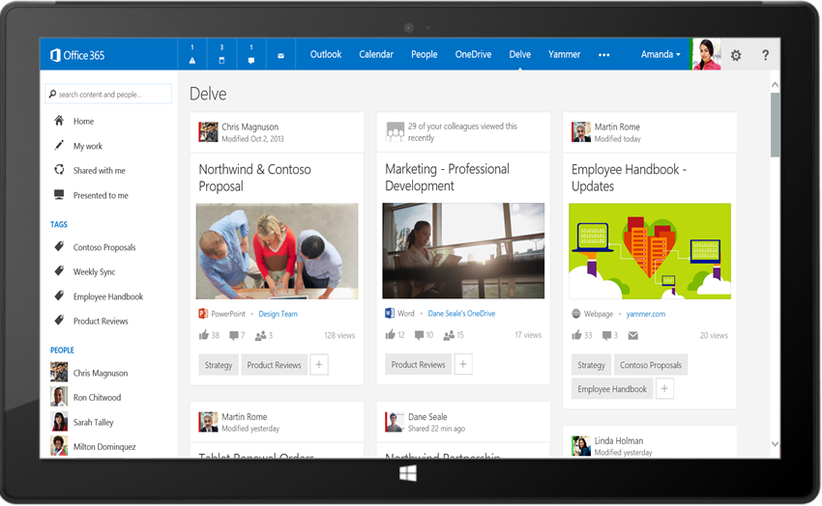
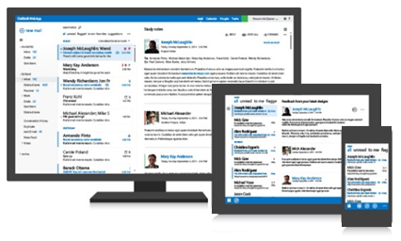
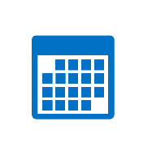



Microsoft Graph API
Your App
https://graph.microsoft.com/
USERS
GROUPS
FILES
MAIL
CALENDAR
TASKS
Insights and relationships from Office Graph

Slide 6
Microsoft Graph, gateway to Office 365
Single resource that proxies multiple Microsoft services
Allows for easy traversal of objects and relationships
Simplifies token acquisition and management
Eliminates the need to traditional discovery (using “me” and “myorganization”)

Slide 7
Office 365 direct API Endpoints
Direct API endpoints for all the Office 365 Services may also be invoked
Outlook, OneDrive, OneNote, etc.
Direct endpoints have new functionality before it is exposed via the Graph API
Examples:
Outlook web hooks
Time zone on calendar

Slide 8
Accessing the Microsoft Graph
Direct REST API
Any platform
Any language
Any framework
Native SDKs
Utilize framework & platform specific implementations
Abstracts the details of constructing & processing REST requests over HTTP
.NET, iOS, Android, PhP, Ruby, JavaScript, etc.

Slide 9
Microsoft Graph REST API

Slide 10
/me
USER
ME
userPhoto
thumbnailPhoto
responsibilities
department
pastProjects
aboutMe
hireDate
birthday
address
mobile
jobTitle
schools
name
skills
tags
alias

Slide 11
Code
GET https://graph.microsoft.com/v1.0/users/yina@contoso.com
GET https://graph.microsoft.com/v1.0/me
GET https://graph.microsoft.com/v1.0/contoso.com
/users/<id>
GET https://graph.microsoft.com/v1.0/contoso.com
/users/yina@contoso.com?$select=aboutMe
GET https://graph.microsoft.com/v1.0/me/photo

Slide 12
/users
manager
USER
directReports
memberOf
GROUPS

Slide 13
Code
GET https://graph.microsoft.com/v1.0/me/manager
GET https://graph.microsoft.com/v1.0/contoso.com
/users/yina@contoso.com/directReports
GET https://graph.microsoft.com/v1.0/me/memberOf
GET https://graph.microsoft.com/v1.0/users/<id>
GET https://graph.microsoft.com/v1.0/contoso.com/users/<id>/photo

Slide 14
/messages
manager
USER
directReports
memberOf
GROUPS
MESSAGES

Slide 15
Code
GET https://graph.microsoft.com/v1.0/me/messages
GET https://graph.microsoft.com/v1.0/me/messages?$top=5
GET https://graph.microsoft.com/v1.0/me
/messages?$top=5&$skip=5&$orderby=DateTimeCreated
GET https://graph.microsoft.com/v1.0/me
/messages?$top=5&$select=Subject,Sender&
$search="from:alexd@contoso.com"

Slide 16
/events
manager
USER
directReports
EVENTS
memberOf
GROUPS
MESSAGES
MESSAGES

Slide 17
Code
GET https://graph.microsoft.com/v1.0/me/events
GET https://graph.microsoft.com/v1.0/me/events?$top=5
GET https://graph.microsoft.com/v1.0/me
/calendarview?startdatetime=2015-04-01t01:00:00z
&enddatetime=2015-04-16t23:00:00z

Slide 18

/drive
Shared with me
createdBy
public
manager
USER
directReports
directReports
EVENTS
EVENTS
modifiedBy
FILES
memberOf
GROUPS
MESSAGES

Slide 19
Code
GET https://graph.microsoft.com/v1.0/me/drive/root/children
GET https://graph.microsoft.com/v1.0/me/drive/items/<id>
GET https://graph.microsoft.com/v1.0/me
/drive/items/<id>/lastModifiedByUser
GET https://graph.microsoft.com/v1.0/mary@contoso.com/drive
/root/children
GET https://graph.microsoft.com/v1.0/mary@contoso.com
/drive/items/<id>/lastModifiedByUser/manager

Slide 20
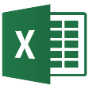
/tasks
trendingAround
trendingAround
Shared with me
createdBy
CONVERSATIONS
public
manager
USER
workingWith
directReports
directReports
directReports
directReports
EVENTS
EVENTS
trendingAround
trendingAround
modifiedBy
TASKS
FILES
memberOf
memberOf
memberOf
workingWith
TASKS
GROUPS
GROUPS
GROUPS
createdBy
MESSAGES
FILES

Slide 21
Code
GET https://graph.microsoft.com/beta/me/tasks
GET https://graph.microsoft.com/beta/contoso.com
/users/yina@contoso.com/tasks
GET https://graph.microsoft.com/beta/contoso.com
/groups/<id>/tasks

Slide 22
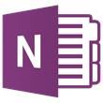
API
trendingAround
Shared with me
createdBy
CONVERSATIONS
public
manager
USER
workingWith
directReports
EVENTS
trendingAround
modifiedBy
TASKS
FILES
memberOf
workingWith
TASKS
GROUPS
createdBy
NOTES
NOTES
MESSAGES
FILES

Slide 23
Azure AD Applications: The Microsoft Graph Dependency
All Microsoft Graph access options (REST API / SDKs) depend on Azure AD
Must register an Azure AD application to access the Microsoft Graph
Use the Azure AD application to authenticate, gain authorization & obtain an access token
Access token included in the underlying HTTP request to call the Microsoft Graph endpoint

Slide 24
Single authentication flow for Office 365
Sign users in using OpenID Connect
Azure AD and Office 365 services
Supports MFA and federated user sign-in
Device apps, web sites, SPAs, and service apps
Pin apps to Office 365 app launcher from My apps

Slide 25
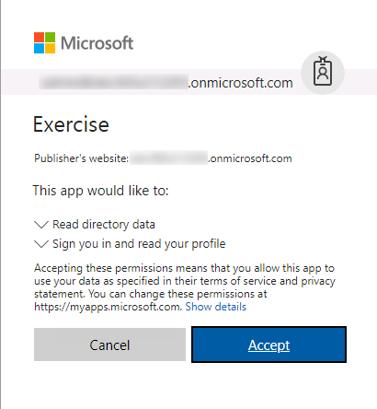
Common consent
Single auth flow for accessing all O365 services
Admin and end-user consent
Secure protocol
OpenID Connect and OAuth 2.0
No capturing user credentials
Fine-grained access scopes
Long-term access through refresh tokens

Slide 26
Authentication Options
Azure AD only
Separate auth flow supports Azure AD accounts only
Azure AD and Microsoft Accounts
Converged auth flow supports Azure AD accounts and Microsoft accounts (LiveID - hotmail.com, etc.)

Slide 27
Microsoft Account + Azure AD
Many apps want to sign users in from both Microsoft account and Azure AD
Single endpoint, OpenID Connect and OAuth 2.0
Single SDK
Single end user sign in experience
Single app registration experience
Works with Microsoft Graph
Single API endpoint, business and consumer data

Slide 28
Registering an Azure AD application for interacting with the Microsoft Graph

Slide 29
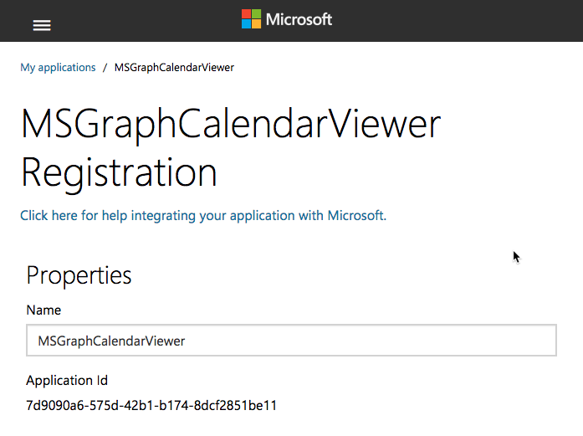
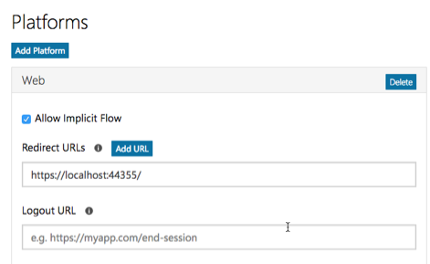
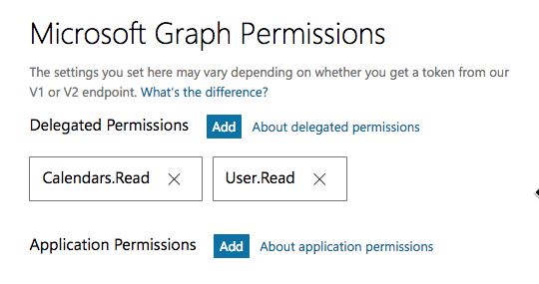
Application registration
Create a new application
Create a new application in the Application Registration Portal. A unique identifier is created for your app.
Add a Web platform
Add a web platform to your application registration.
Optionally add permissions
Add permissions that your application will need if your admin will consent for all users. Or leverage dynamic consent for requesting permissions.

Slide 30
Demo

Slide 31
Thank you.

